Slide 2
What is Evernote?
A platform where you can capture anything and access it anywhere.
For example: type a note, store a document, take a photograph or record audio notes.
Evernote will then sync it across all your different devices.

Slide 3
Why use Evernote?
Take notes during meetings
Save information from the Internet that you don’t want to forget
Capture pictures and save them for later
Take audio notes
Stay organized
Share your notes with others

Slide 4
How Evernote Works
Create a free account
Start by creating a note, adding an image, or starting a notebook with a few easy clicks
Save content from the Web
Sync your items across any and all devices
Add, organize, save, and sync
Use different notebooks for lesson plans, activities/handouts, notes you want to share with students, portfolios, etc.
Search for apps that are compatible with your platform to extend the activities and usage of Evernote to meet your needs

Slide 5
Evernote Platforms
Mobile
iPhone
iPad
iPod Touch
Windows Phone
Windows 8 (Touch)
Android
BlackBerry
WebOS
Desktop
Mac OS X
Windows Desktop

Slide 6
Evernote Web App

Slide 7
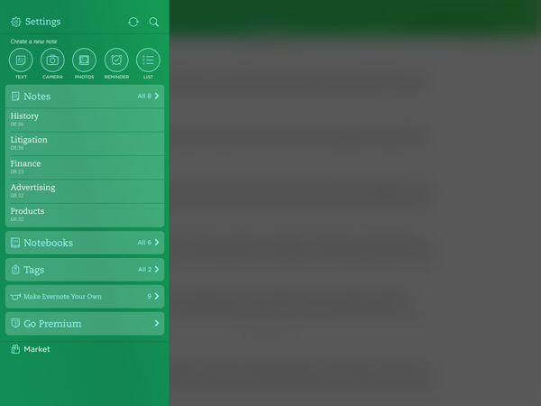
Evernote for iPad, iPhone and iPod
Quicknotes: type text, choose a picture from devices, capture a photo, create reminders, create a list.
Notes: Displays all of the notes in your account with the most recent on top.
Notebooks: Displays your different notebooks in your account
Tags: Shows a list of current tags used in your account

Slide 8
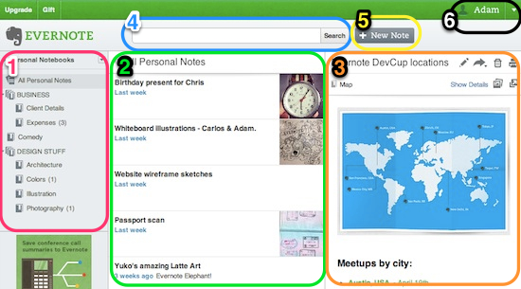
Evernote for the Web
Sidebar: browse the content of your account by notes, notebooks, or tags.
Note List: displays all notes, chronologically by the date they were last updated
Note Editor: view and edit the note you have selected
Search: find content in your account by searching keywords, tags, attachments, etc.
New Note Button: create a new blank note in your currently selected notebook
Account Information Menu: manage your settings, log out, etc.

Slide 9
Evernote in the Classroom

Slide 10
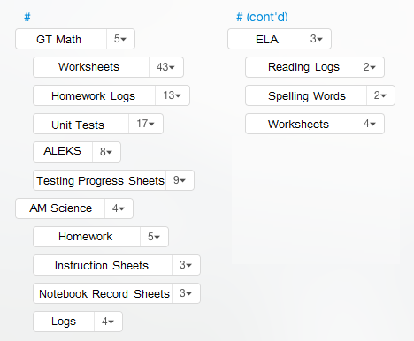
Organize your Classes with Tags
Unlike notebooks, tags can be organized in a hierarchy that makes sense for you.
You can create groupings for each class and then individual tags for what describes each item needed for that class.

Slide 11
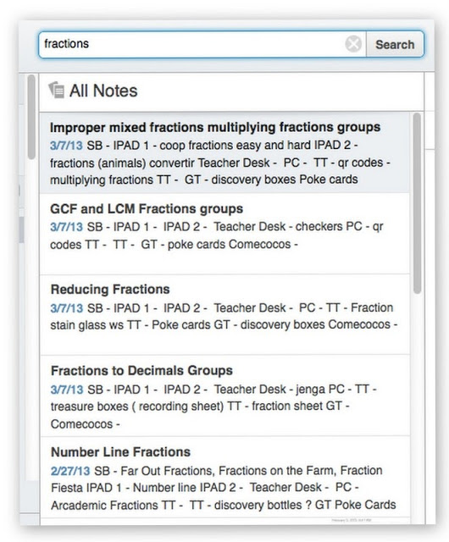
Save and Share Lesson Plans
By saving all of your lesson plans you have access to them anywhere you are.
The search feature allows you to locate your lessons based on their topic.

Slide 12
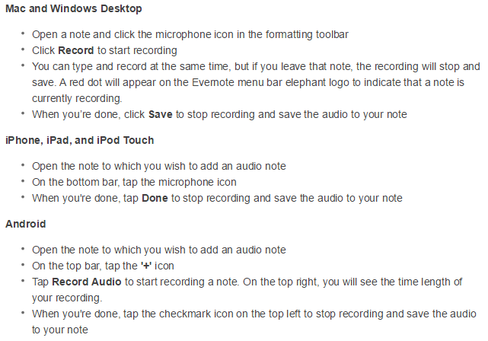
Record IEP Meetings
Record and save audio
Add personal handwritten or typed notes
Compile a notebook for each student that includes audio, notes, images, etc. for their IEP

Slide 13
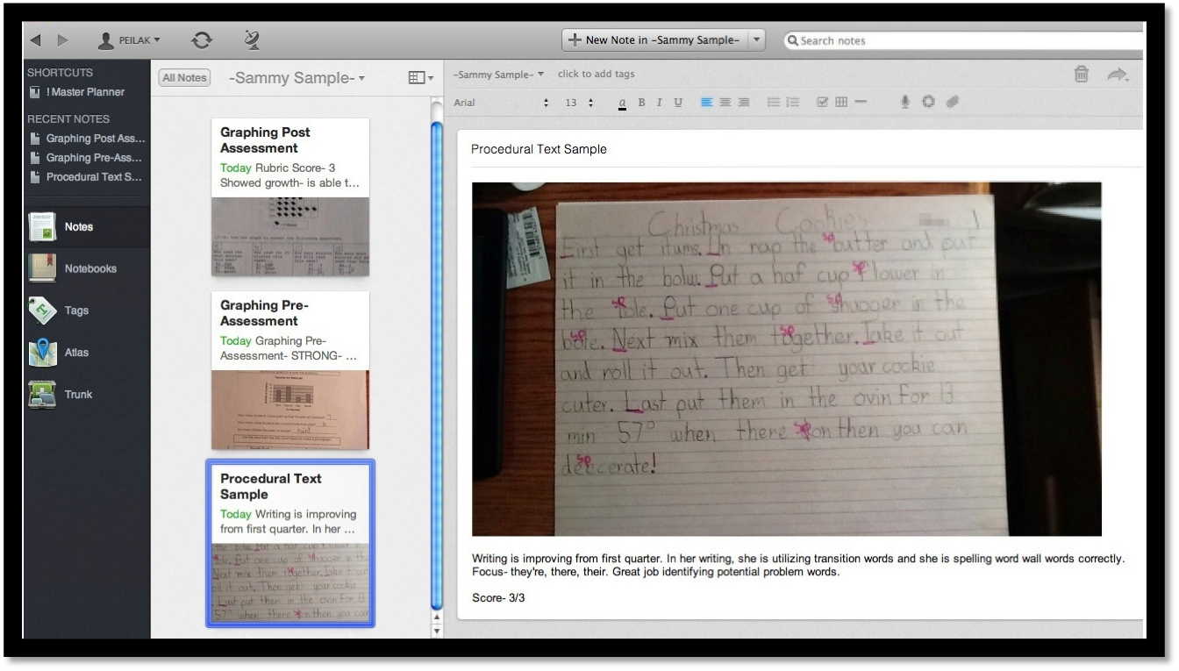
Upload Student Work
Creating notebooks for each student allows you to save writing samples, take pictures of journals or projects and scan other student work.
Student notebooks can also be shared with parents.

Slide 14
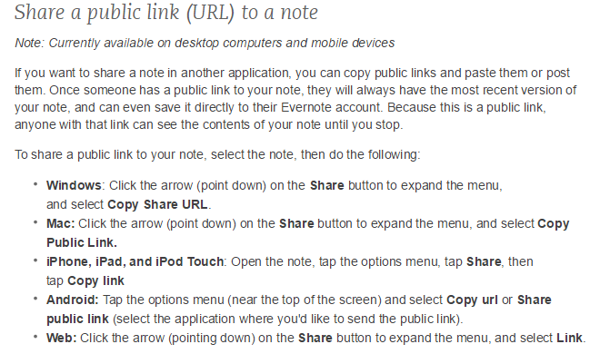
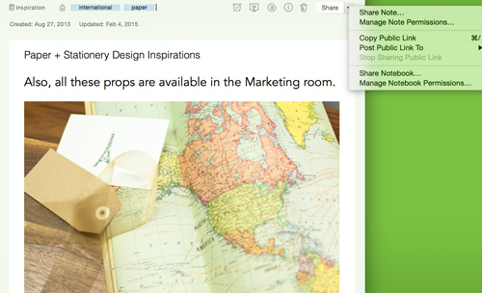
Share Notes with Students

Slide 15
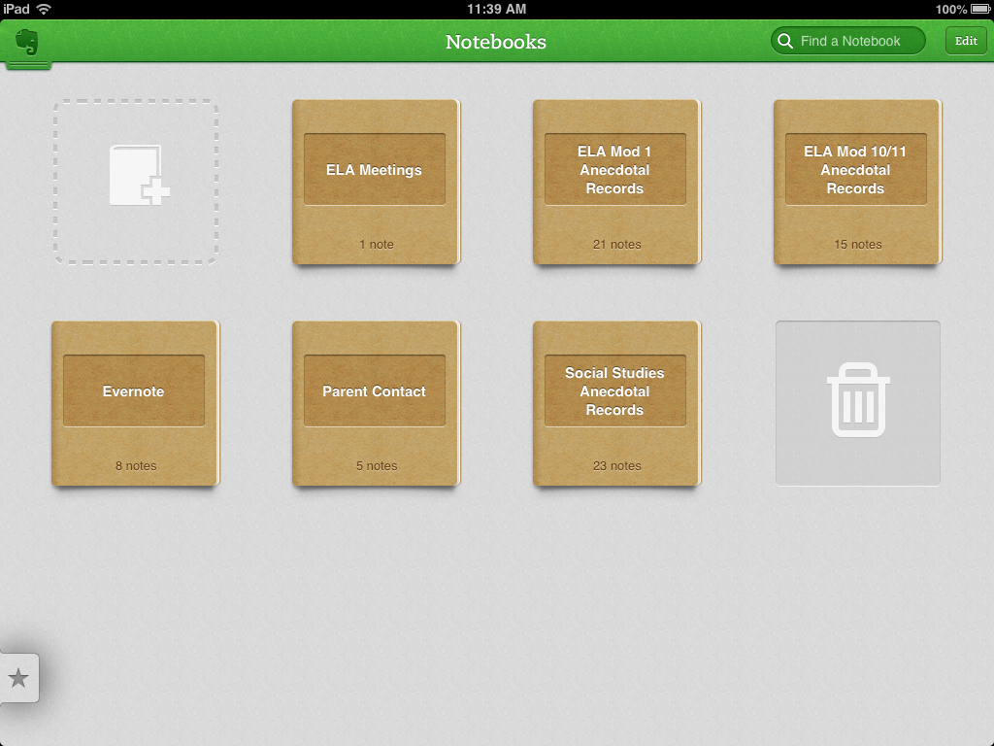
Document Communication with Parents
Keep a notebook that is dedicated to just communication with parents.
This allows you to have all notes and information handy.

Slide 16
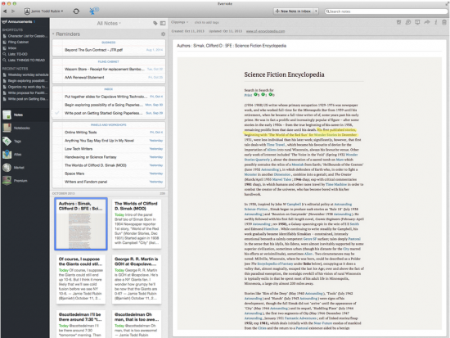
Organize Project Research
Create a notebook for research papers. then your students web clippings, audio, notes and images can all be held in one place.

Slide 17
Questions?

